Slide 1


Product Teardown: ‘Amazon Returns’
By Vidhu Jha

Slide 2

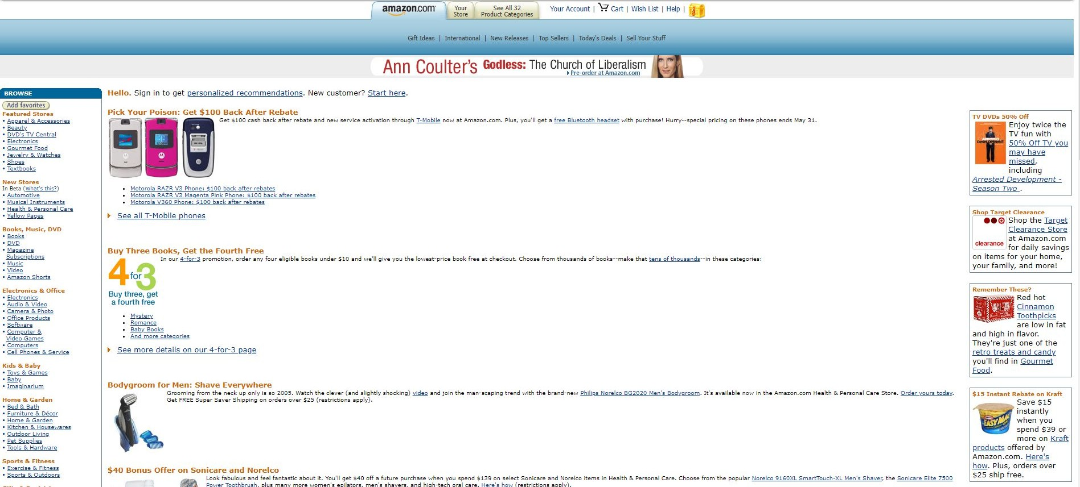



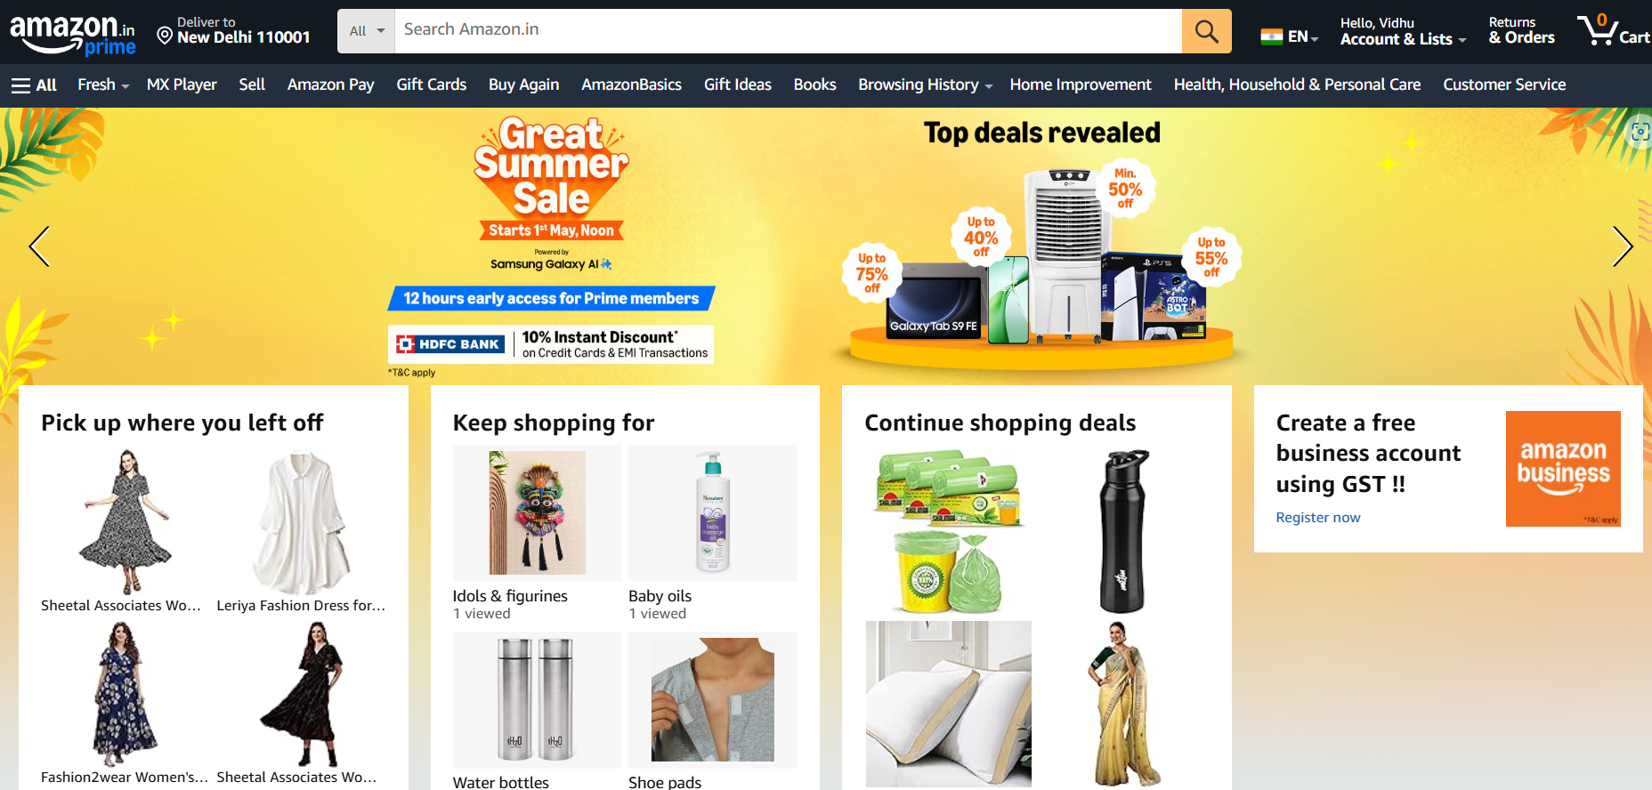







About Amazon
Amazon Website: 1998
Based on sales and market value, Amazon is the world's largest online retailer. This online business has changed the way people do business all over the world. Jeff Bezos founded Amazon on July 5, 1994, in Washington, D.C. He was the company's CEO until July 2021. On July 5, 2021, Andy Jassy was appointed President and CEO of Amazon.
Facts about Amazon
Amazon plans to create one million jobs in India by 2025
Amazon India will have 10,000 electric vehicles in its delivery ﬂeet by 2025.
Jeﬀ Bezos
Amazon has eliminated over 1 million tons of packaging material since 2015.
Amazon India donates one lakh N95 masks, 40K hygiene kits, and 65K PPE to frontline health workers.
Amazon Website: 2025
Amazon India has successfully eliminated 100% single-use plastic in packaging across its Fulfilment Centres.
Andy Jassy
Logo Evolution
1995-1997
1997-1998
1998
1998
1998-2000
2000-Present

Slide 3
















User Personas
User Personas
Sarah, 29, Female
Social Butterfly
CORE NEEDS & GOALS
Loves sales and deal oﬀers on products
Very active on social media: loves writing reviews
Loves to purchase several pairs for diﬀerent occasions
User Journey Map
PAIN POINTS
Adam, 52, Male
Brand Devotee
-Finds it a hassle to purchase shoes and clothes wondering if they will fit or not
CORE NEEDS & GOALS
-Finds most quality of products not up to the mark, is very particular about her purchases and making sure she gets the right product.
Always on the lookout for loyalty programs
Make sure product is returnable prior to purchase
Product Quality and Life-Cycle very important to him
User Experience
-Hates that she has to carry a lot of bags while shopping, so finds online shopping very convenient
PAIN POINTS
-Seeks fast delivery and a smooth experience
with regards to online shopping.
-Does not have the time to go in-person and shop, has to rely on the quality of online products. Has trouble with returning and refunding with most merchants, is skeptical about trusting e-commerce websites.
Key Metrics
Portraits from. iStock

Slide 4


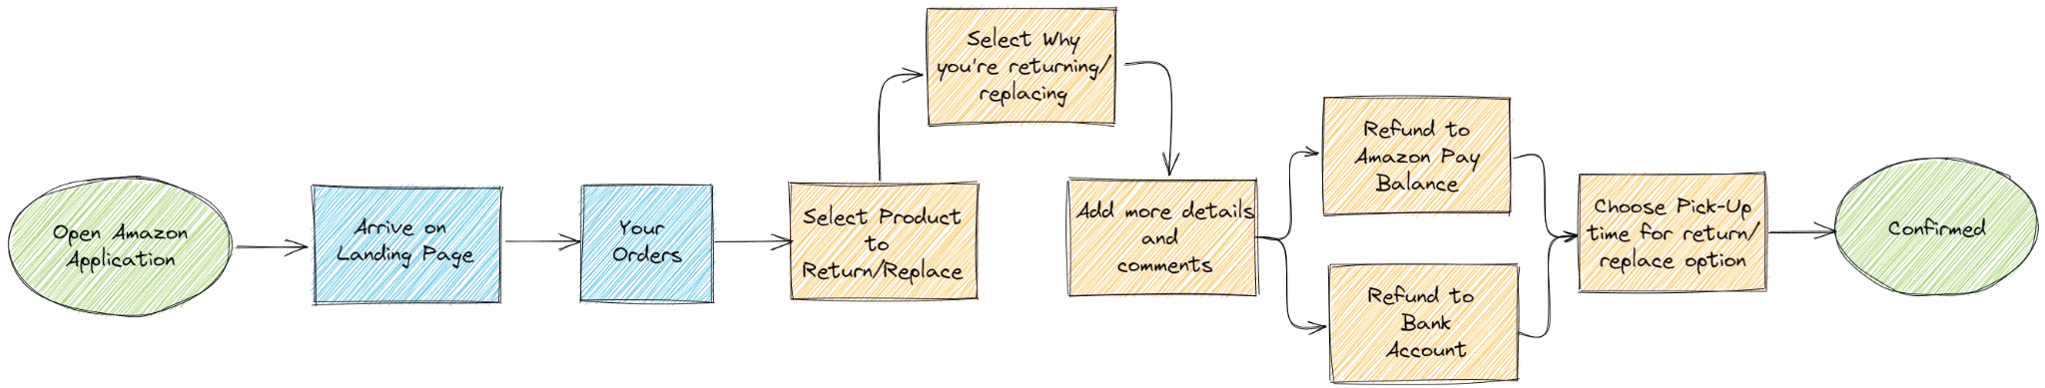


Journey Map
User Personas
User Journey Map (1/4)
User Experience
1
2
3
4
5
OPEN AMAZON
Go to Your Orders and Locate Order
Select Item and Choose Reason for Return
Select Refund or Replacement Option
CONFIRM RETURN
Key Metrics

Slide 5

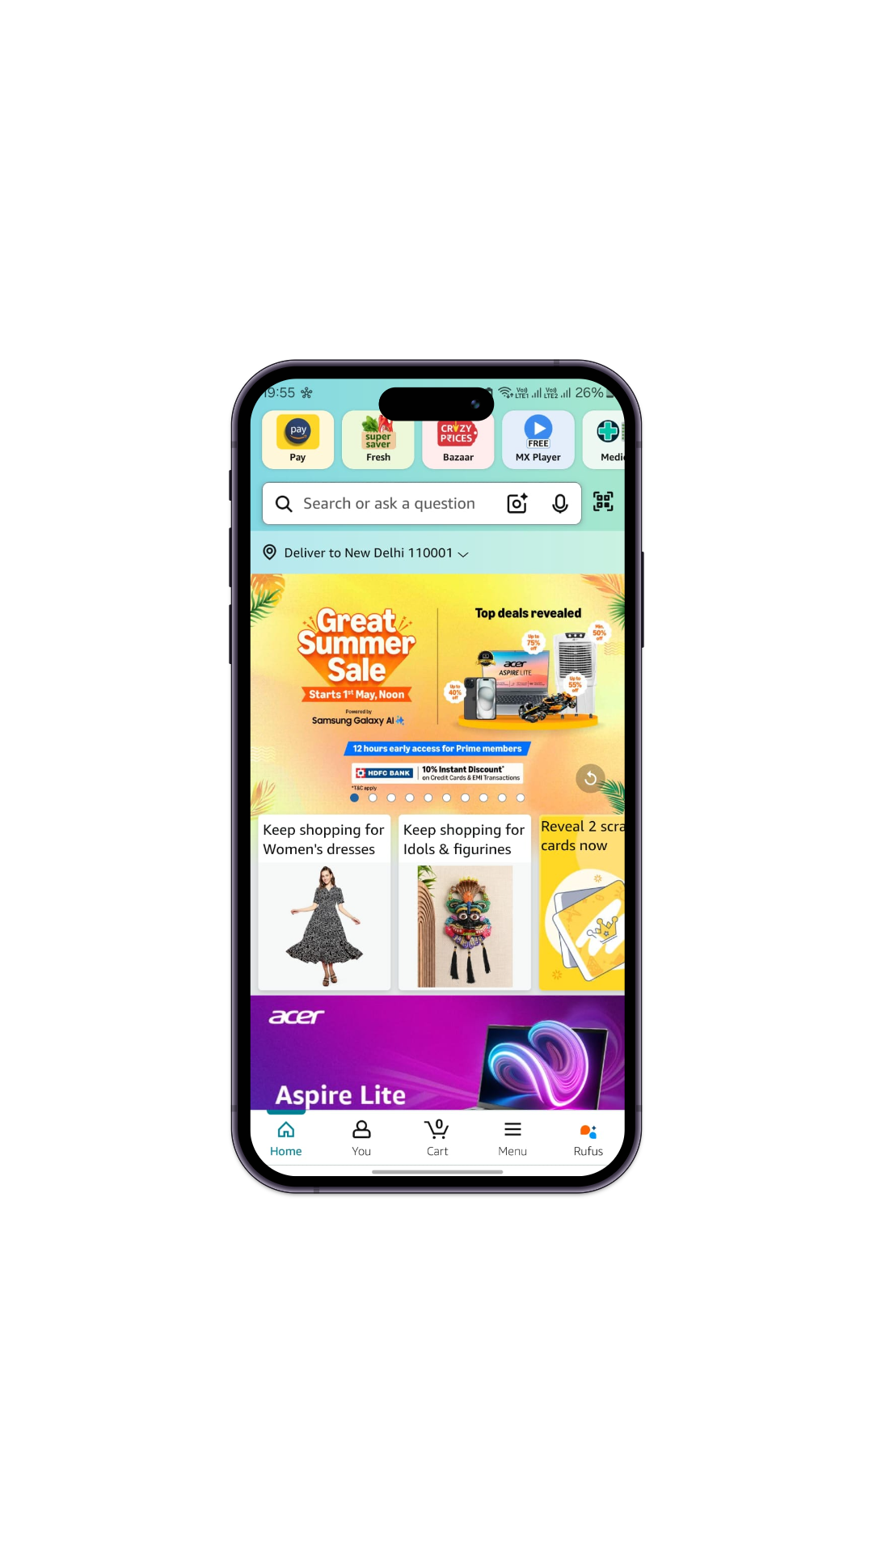
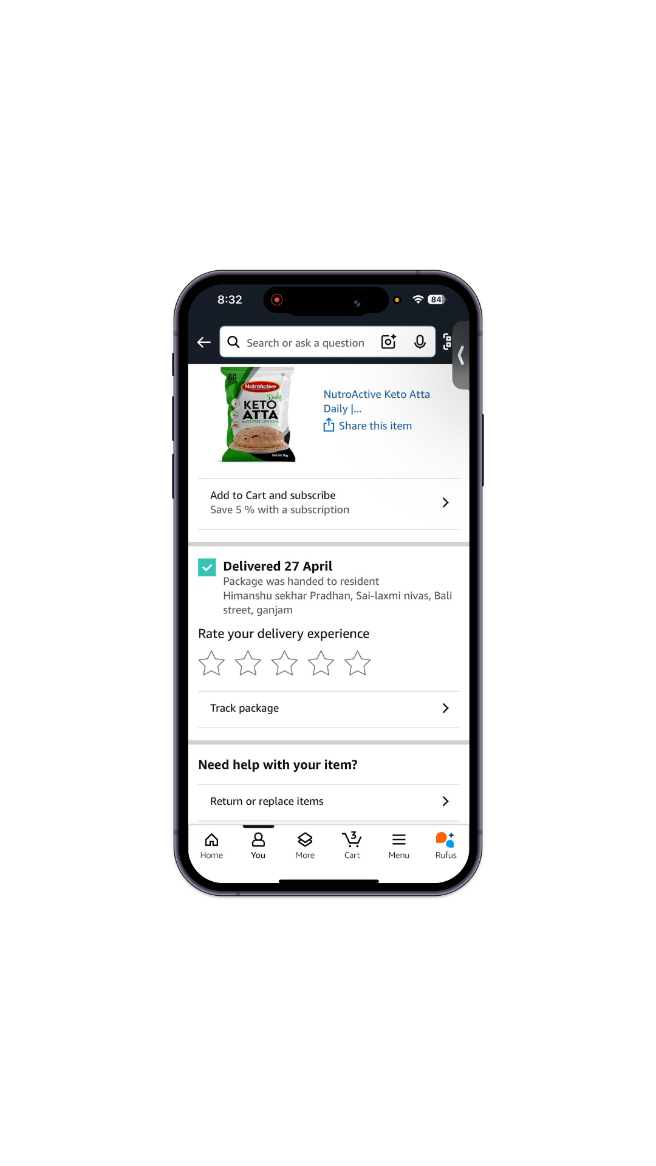
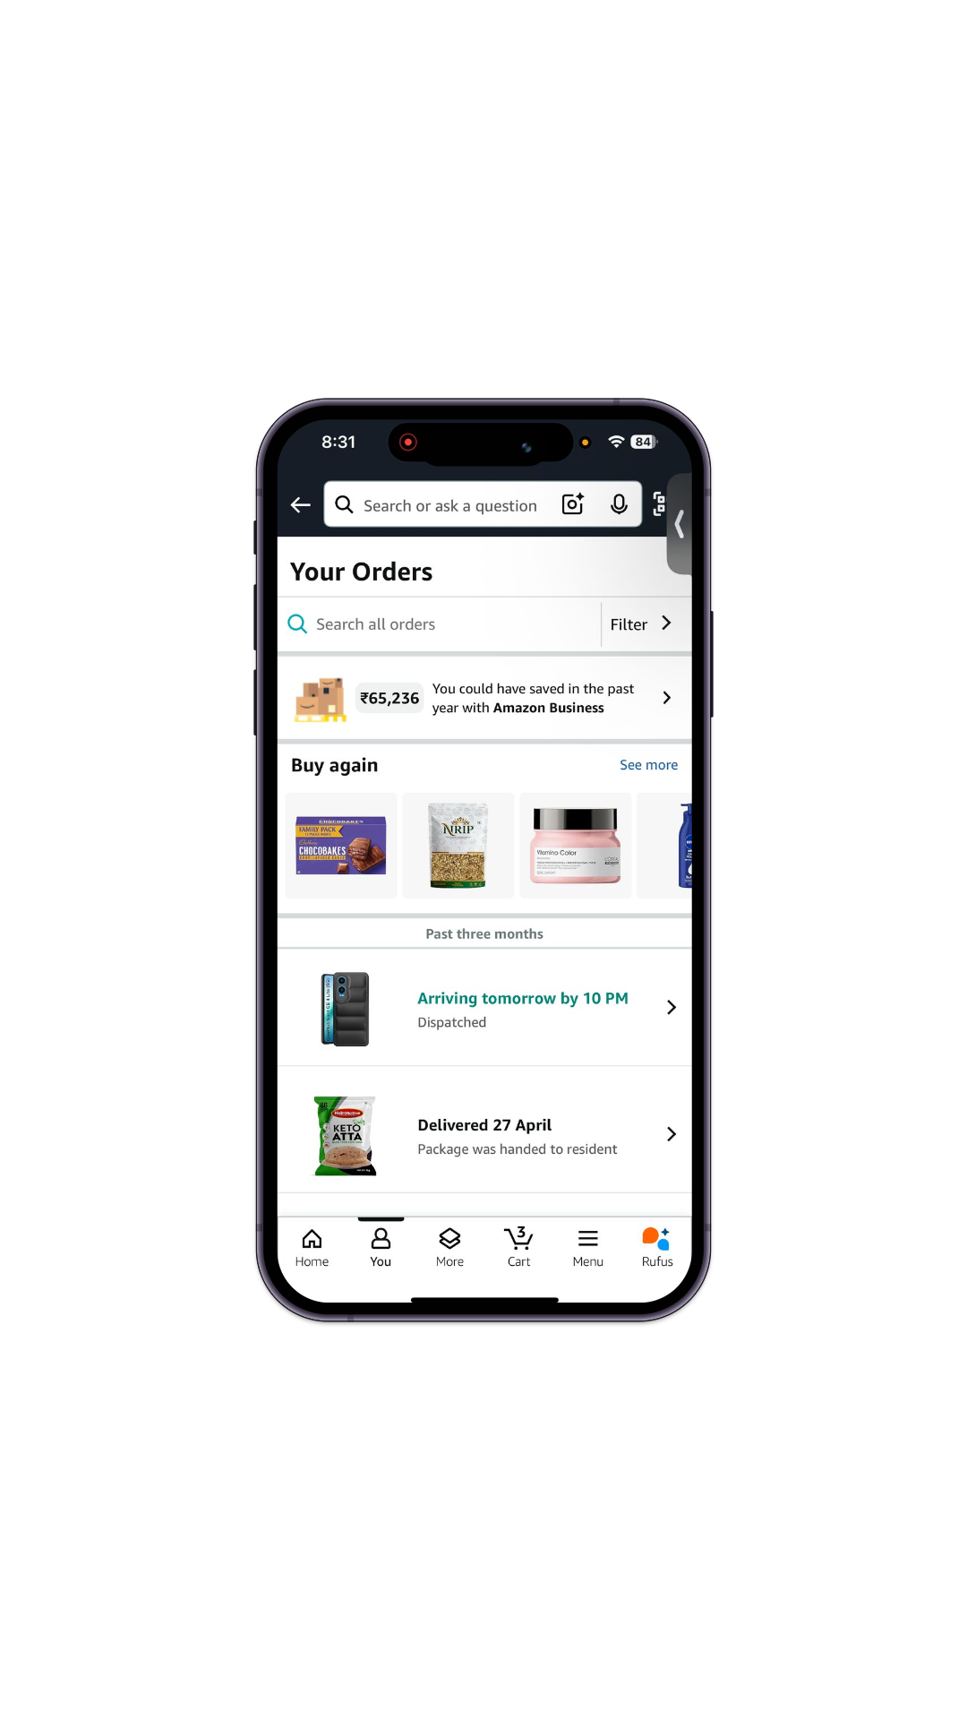
User Personas
Process/Flow
User Journey Map (2/4)
User Experience
Step 1: Open App
Step 2: Landing Page
Step 3: Your Orders
Step 4: Return/Replace
UX Element standing out
-
Simplified segmentation of landing page icons
Provision of ‘Buy Again’ feature
Return/Replace eligibility date
clearly specified
Hypothesis on why
its built this way
To lead users to prime activity points: Cart, Home, User Past Purchases, etc.
Encourage users to purchase their past bought items without having them search for it all over again
Users would have the time frame of returning/replacing right there when they check the status of their order
Key Metrics
-

Slide 6
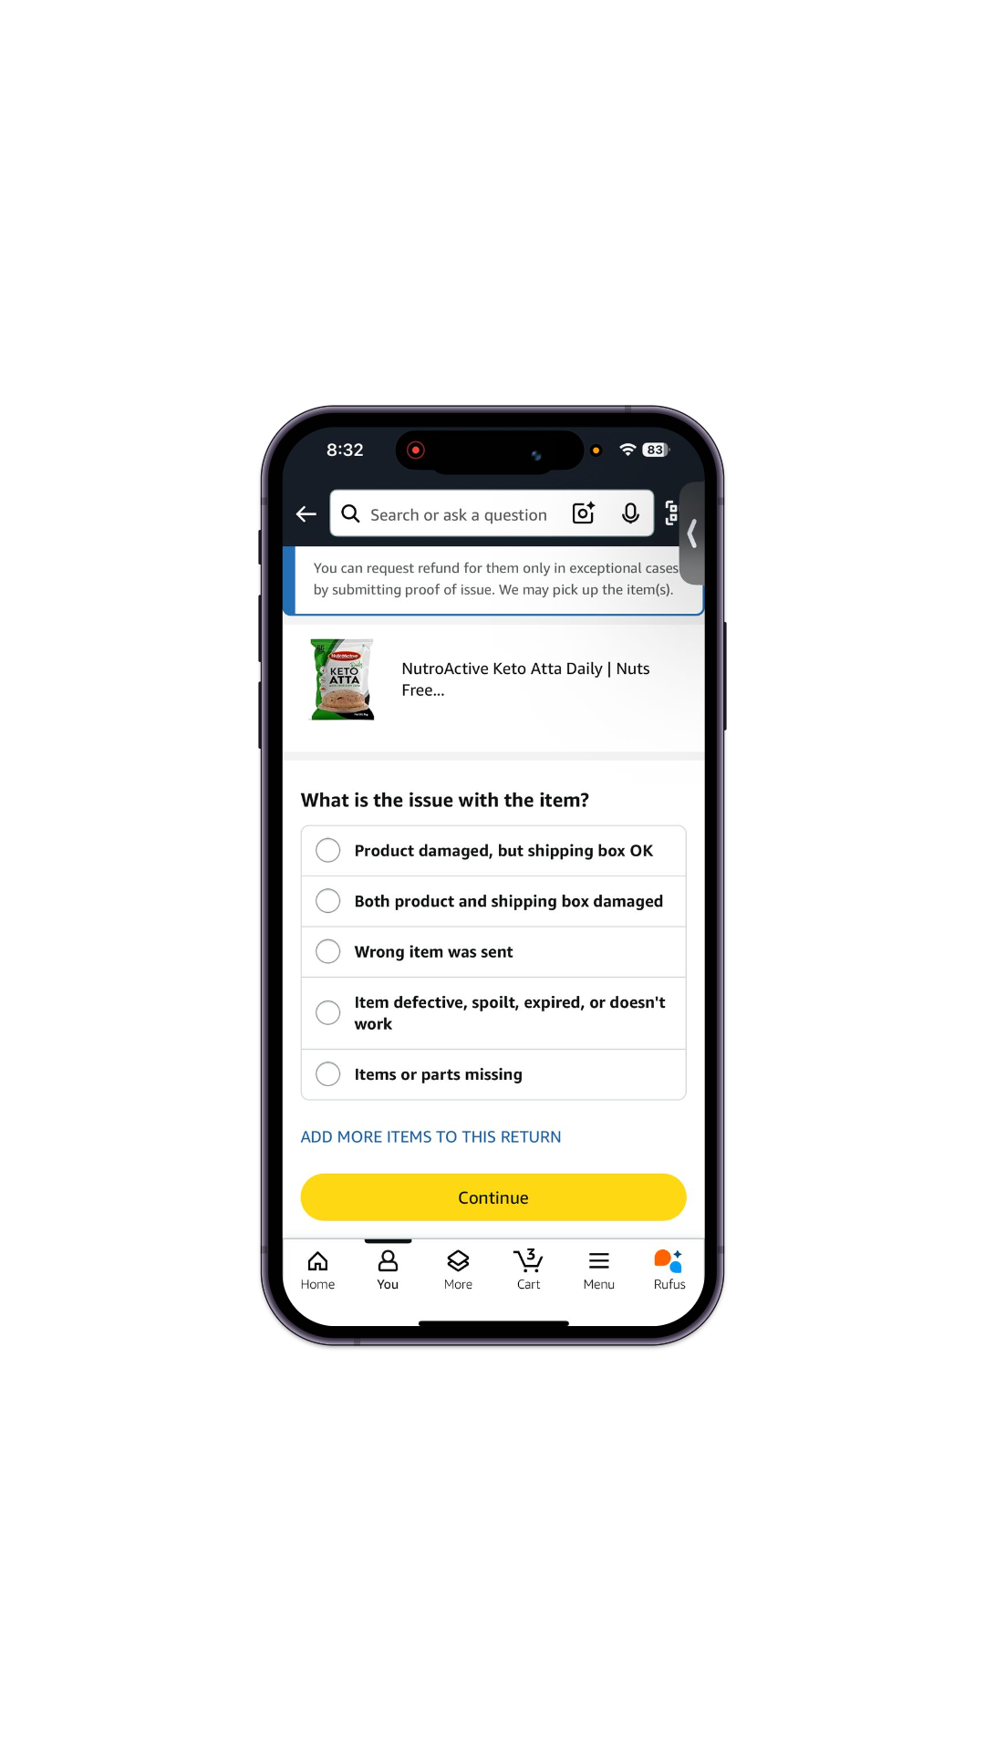
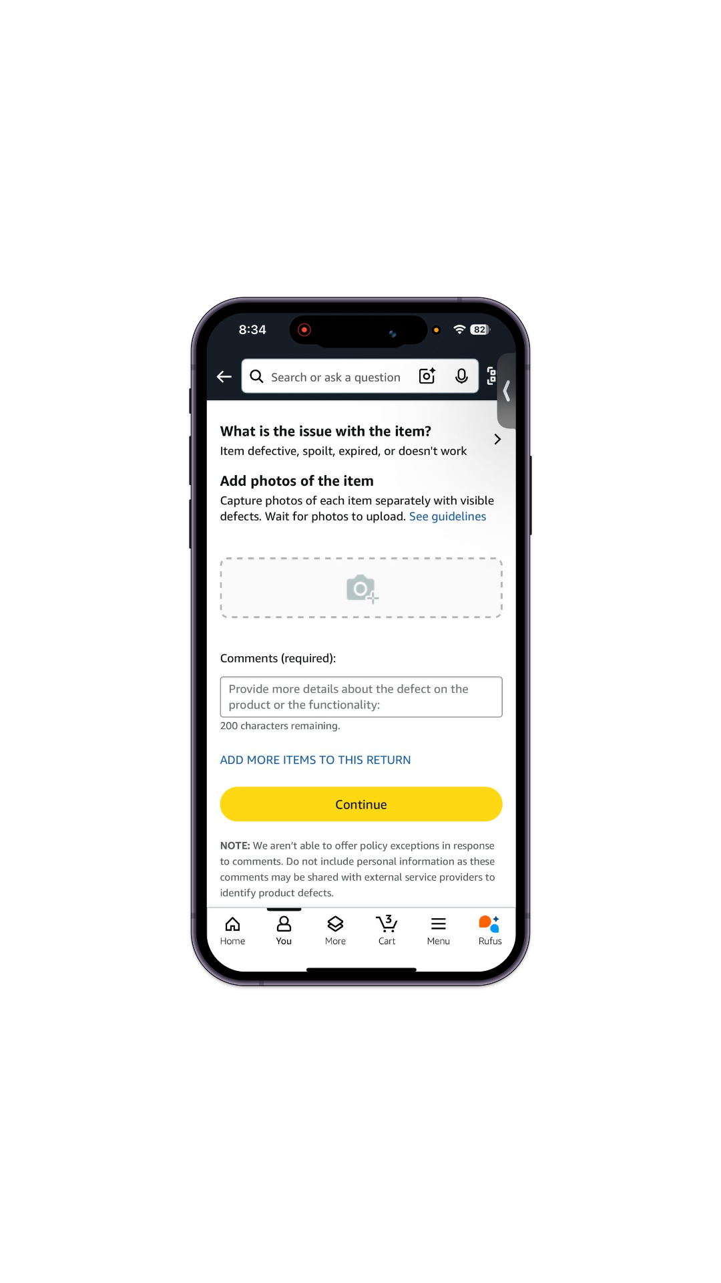
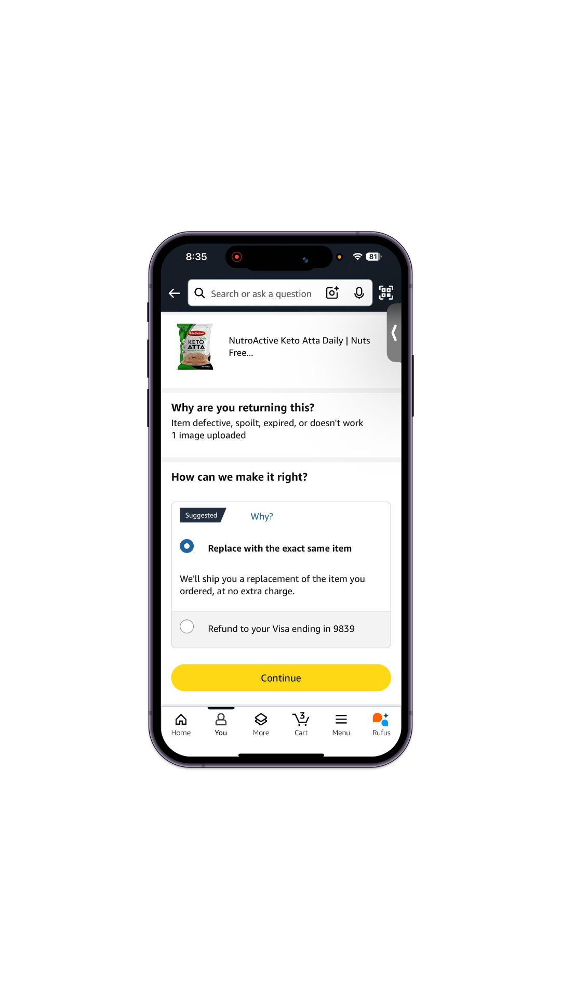
User Personas
Process
User Journey Map (3/4)
User Experience
Step 5: Enter Reasons
Step 6: Additional Info.
Step 7: Comments
Step 8: Refund Mode
UX Element standing out
Exhaustive list of reasons specified for return
Estimated Return date
specified at the bottom
Comments option to let users type in reasons
Amazon Pay balance option for refund
Hypothesis on why
its built this way
User does not have to manually enter/type the reason
User has information beforehand and can return the product on time
For reasons not specified in the lists earlier, users can type in extra comments
Key Metrics
Gives users incentive on letting the money be used for their next amazon purchase

Slide 7



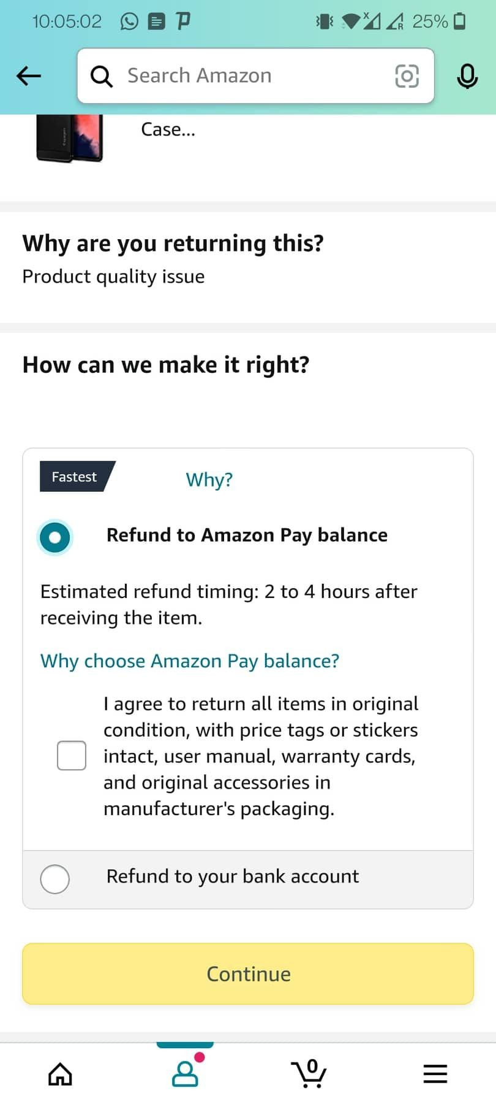
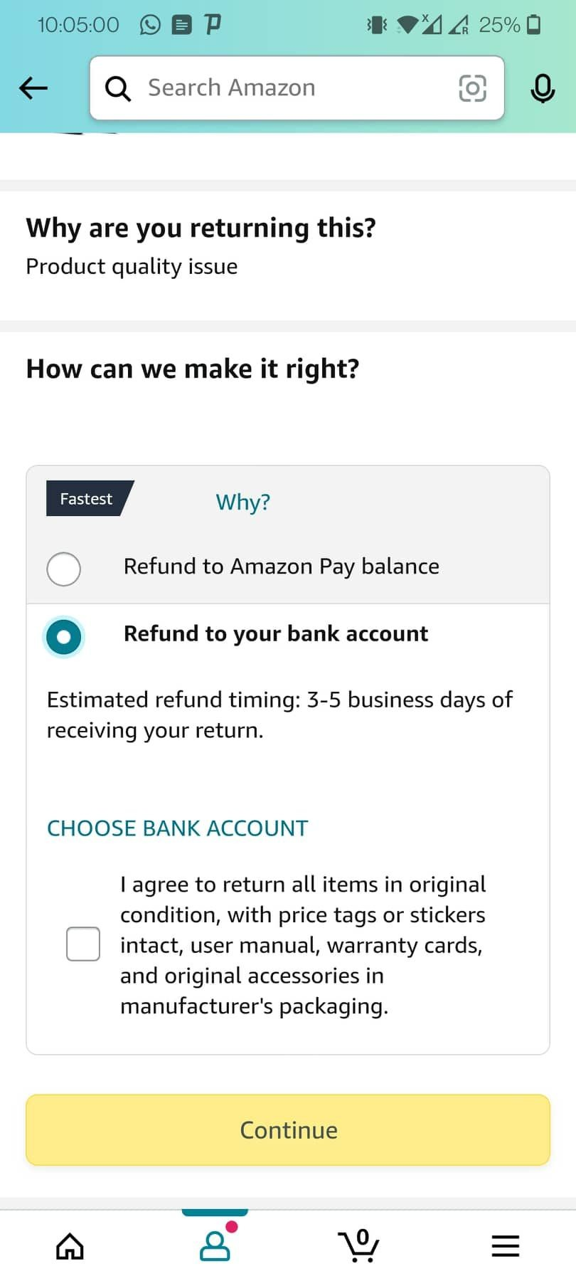
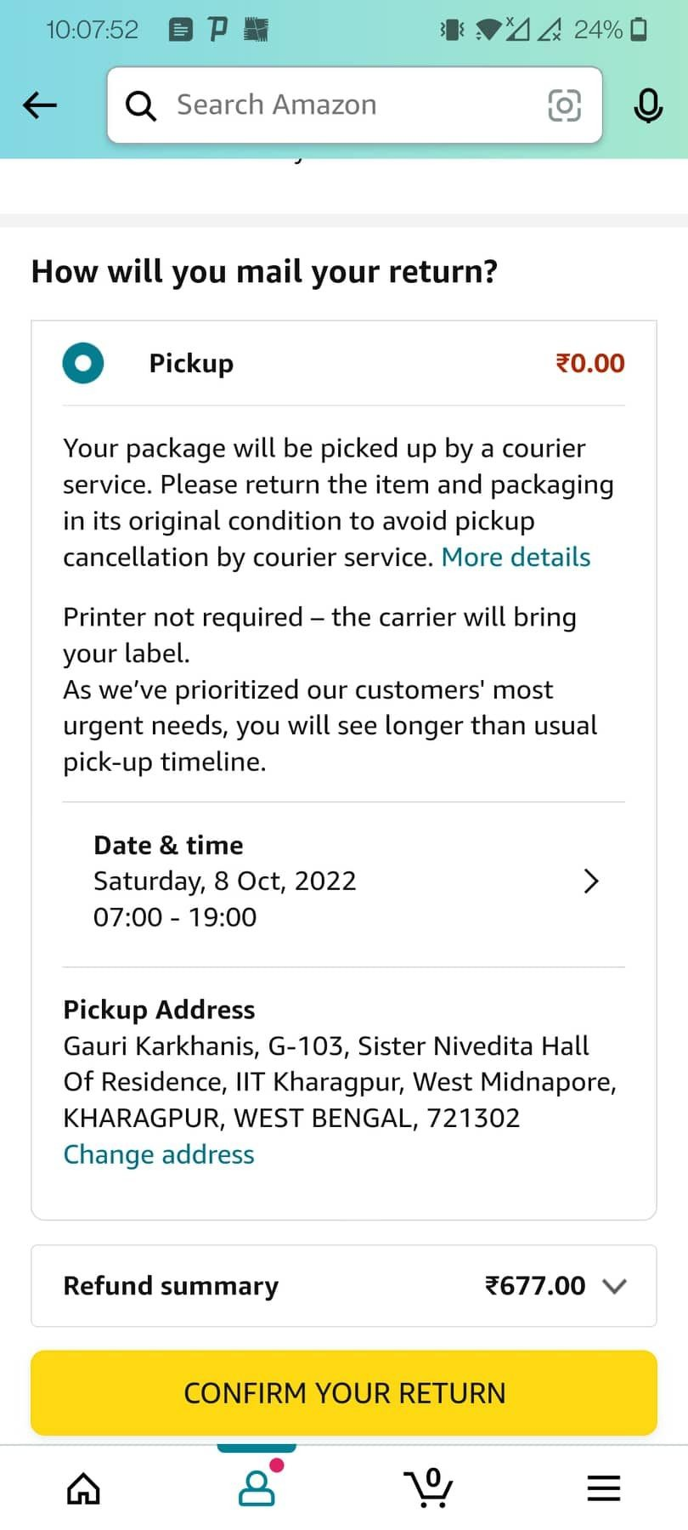
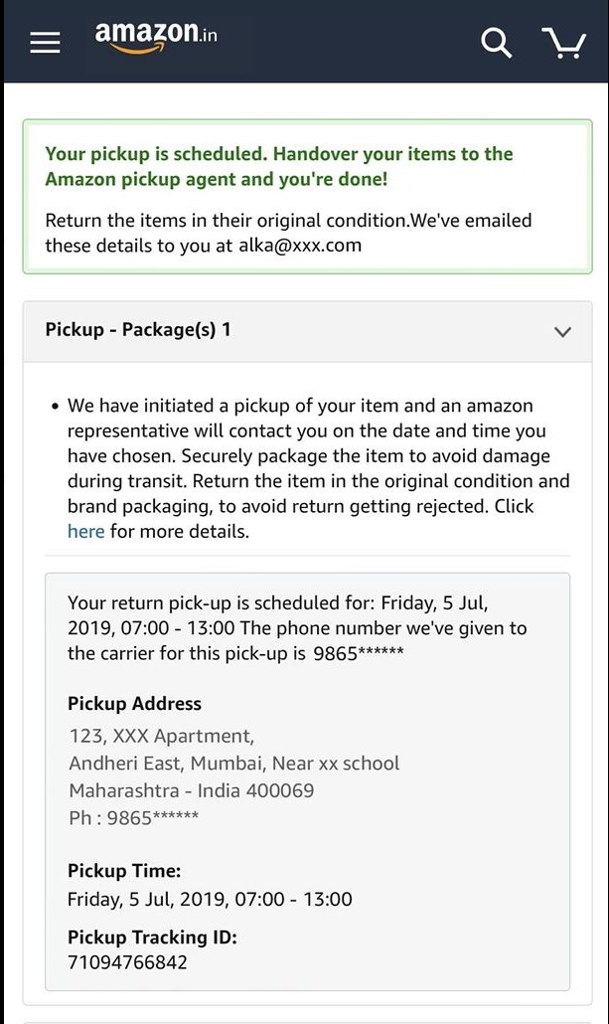
User Personas
Process
User Journey Map (4/4)
User Experience
Step 9.1: Amazon Pay
Step 9.2: Bank Account
Step 10: Pickup Details
Step 11: Confirm Return
UX Element standing out
‘Fastest’ tag next to the Amazon Pay balance option
-
Details of Pickup clearly specified
-
Hypothesis on why
its built this way
User would be motivated to choose a hassle-free faster option and further use Amazon
Gives customers instructions for packaging to not create issues later
Key Metrics
-
-

Slide 8
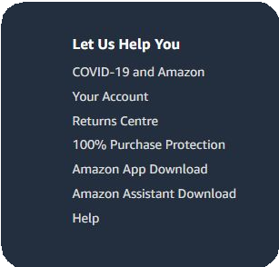
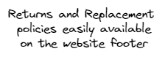

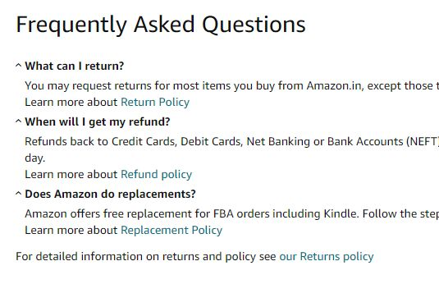




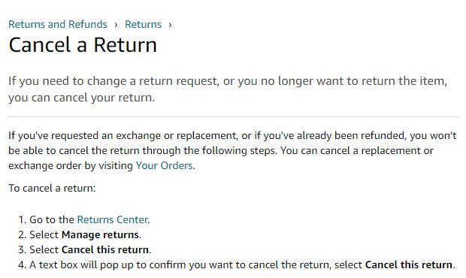
User Experience
What Works!
User Personas
In the world of online shopping, Amazon is renowned for having one of the most customer-friendly return policies. Amazon makes it exceedingly simple for customers to
Overall Rating
return things and simple-to-read and returns and refunds.
receive refunds with comprehend rules for
User Journey Map
A dedicated
"Returns and
Replacements" section, conveniently located in the website footer, serves as Amazon's principal repository for returns documentation.
The most essential thing to keep in mind is that you don't have to phone a customer service agent to make a return request.
User Experience (1/2)
A customer may initiate their own returns or refunds. If an order qualifies for exchanges or repairs, Amazon also makes the process simple for customers.
Customers can also Cancel a Return if they feel they no longer need to return the product.
Key Metrics

Slide 9




User Experience
What
Doesn’t!
The Competitors
My
Recommendations
User Personas
It seems that with recent updates over the past month, the return and replace items feature has been facing glitches. Innumerable customers seem to be complaining regarding rejected requests and non-compliance with the policies.
Firstly, the app glitches
should certainly be addressed. It seems that the return requests are being auto-rejected and not reaching the system’s end.
User Journey Map
Return and Replace requests are either being rejected time over time, or are not being addressed at all. The return period passes, and then it becomes impossible to reach the customer service or return the product.
There are complaints that state how the customer is being called at an address too far away from their home location to return the product themselves.
To reduce the number of returns and replace requests, Amazon can start selling returnable/replaceable items at diﬀerent prices. (For e.g: sell that product at a lower price with non-returnability)
●
User Experience (2/2)
Amazon can start Rental Services: let the user be charged for the time period they are renting for. Charges can be listed for damages and mishandlings done.
A few customers also raised issues regarding not being able to generate requests on their own. They have had to call the customer service in order to place these return requests.
Key Metrics

Slide 10






Key Metrics
User Personas
Metrics to Look Out For!
-Click Through Rate of Return/Replace Button
North-Star Metric
L1 Metrics
L2 Metrics
User Journey Map
-Individual Return and Refund Request Metrics
-Repeating Return Requests metric
# of Returns/Replace Requests of Units in a time period
NPS Scores (Net Promoter Score) or
CSAT Scores (Customer Satisfaction Score)
# of customers opting for Amazon Pay Refund
-Returns Acceptance Rates (To keep check on the automated rejects)
User Experience
# of Delivered Units in a time period
Reduction in return orders for a particular category or time period
To take the number of satisfied customers (those who rated 4 or 5), and divide them by the total number of responses
An increase in Amazon Pay Refund preference would mean growth for Amazon.
Key Metrics

